Slide 1
EMTH403
Mathematical Foundation for Computer Science

Slide 2
Lecture Outcomes
understand what is a biconditional Statements
learn what is equivalence of formulas
understand what is duality law.

Slide 3
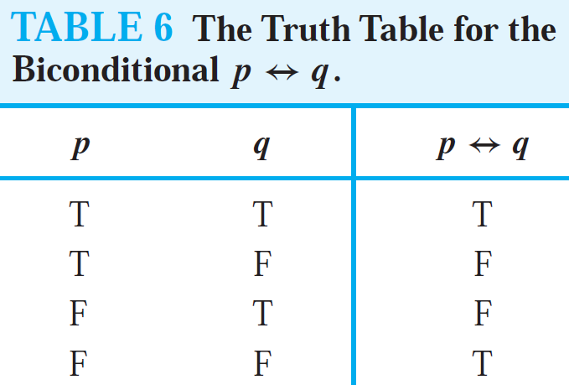
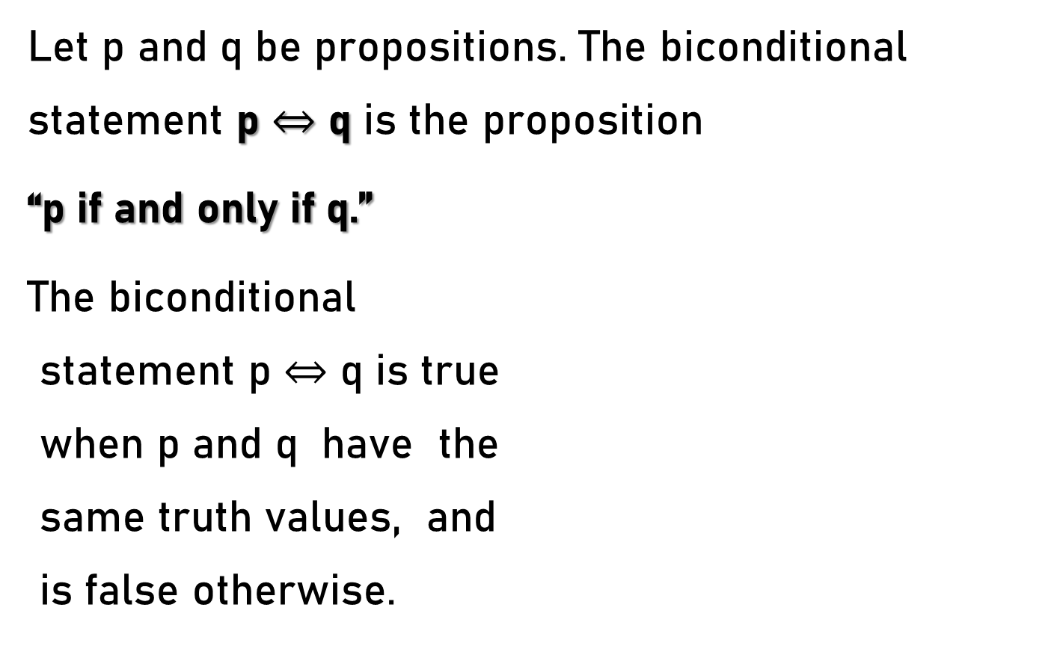
BICONDITIONALS
Let p and q be propositions. The biconditional statement p $⇔$ q is the proposition
“p if and only if q.”
The biconditional
statement p $⇔$ q is true
when p and q have the
same truth values, and
is false otherwise.

Slide 4
BICONDITIONALS
Biconditional statements are also called bi-implications.

Slide 5
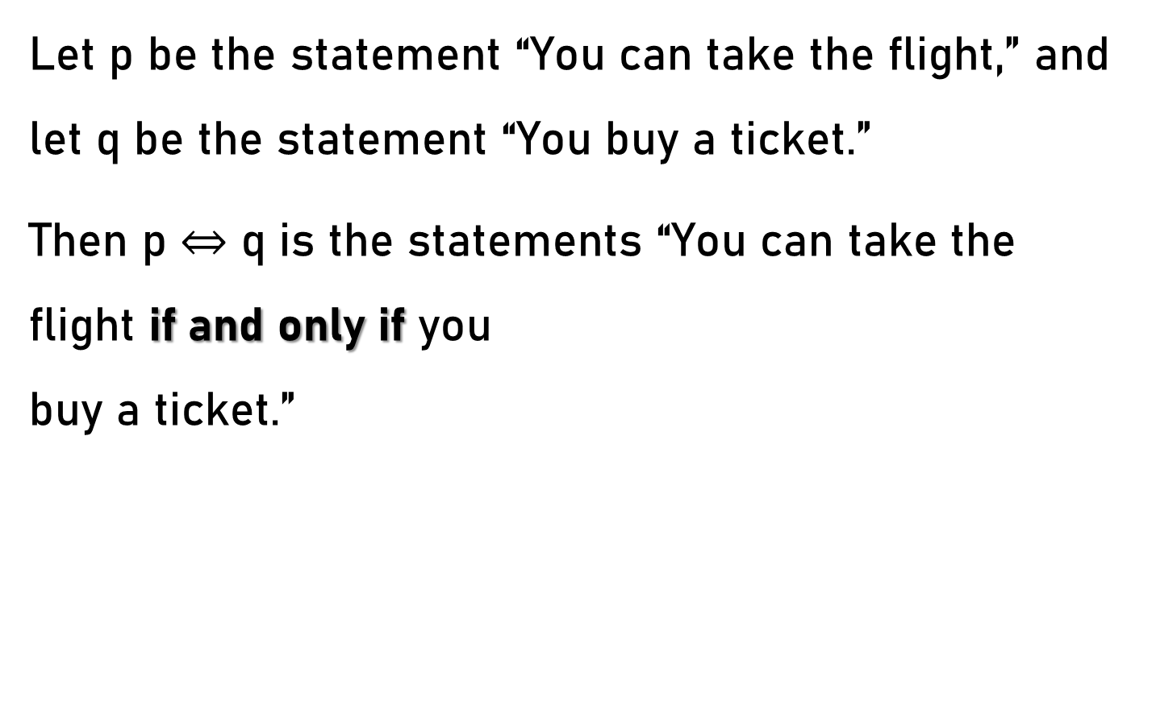
BICONDITIONALS – Example 1
Let p be the statement “You can take the flight,” and let q be the statement “You buy a ticket.”
Then p $⇔$ q is the statements “You can take the flight if and only if you
buy a ticket.”

Slide 6
BICONDITIONALS – Example 1
This statement is true if p and q are either both true or both false, that is, if you buy a ticket and can take the flight or if you do not buy a ticket and you cannot take the flight.

Slide 7
BICONDITIONALS – Example 1
It is false when p and q have opposite truth values, that is, when you do not buy a ticket, but you can take the flight (such as when you get a free trip) and when you buy a ticket
but you cannot take
the light (such as
when the airline bumps
you).

Slide 8
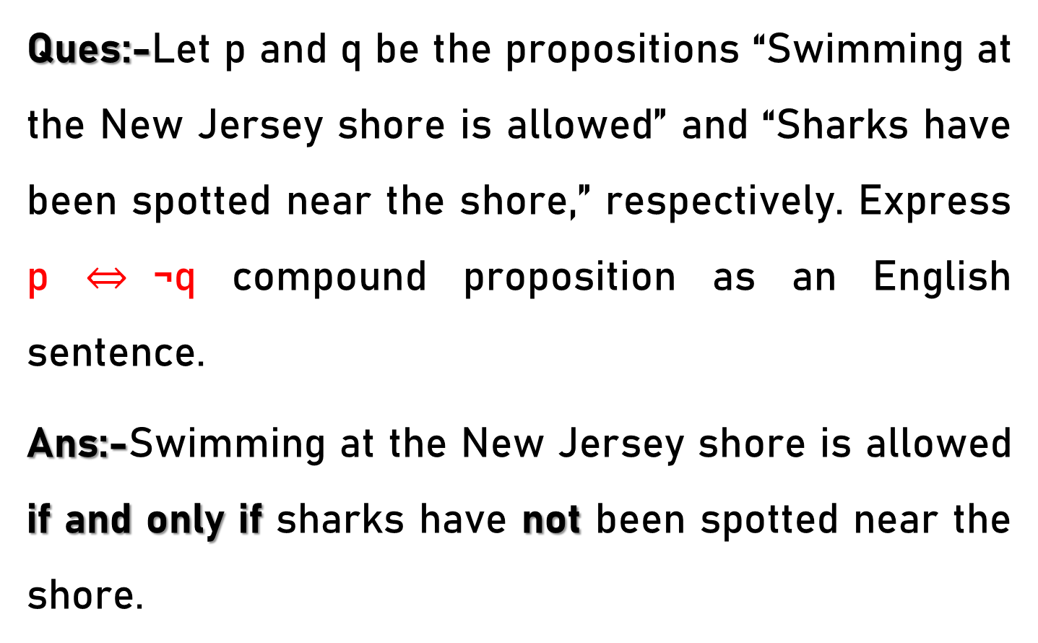
BICONDITIONALS – Example 2
Ques:-Let p and q be the propositions “Swimming at the New Jersey shore is allowed” and “Sharks have been spotted near the shore,” respectively. Express p $⇔$¬q compound proposition as an English sentence.
Ans:-Swimming at the New Jersey shore is allowed if and only if sharks have not been spotted near the shore.

Slide 9
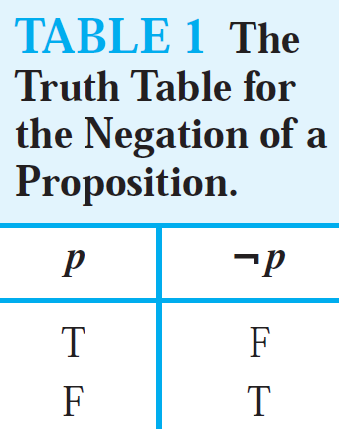
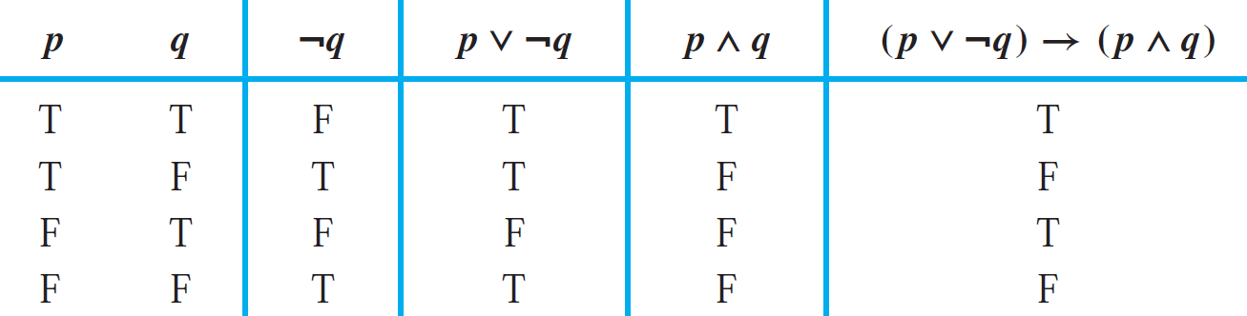
Truth Tables of Compound Propositions
Construct the truth table of the compound proposition
(p ∨¬q) → (p ∧ q).
The Truth Table of (p ∨¬q) → (p ∧ q) is

Slide 10
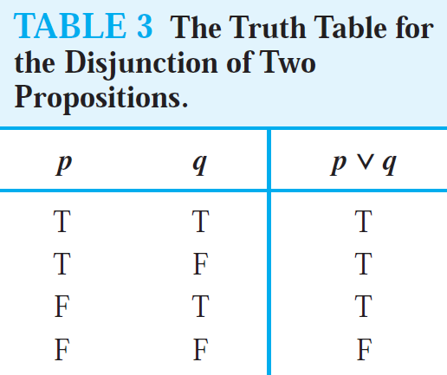
Truth Tables of Compound Propositions
Construct the truth table of the compound proposition
(p ∨¬q) → (p ∧ q).
The Truth Table of (p ∨¬q) → (p ∧ q) is

Slide 11
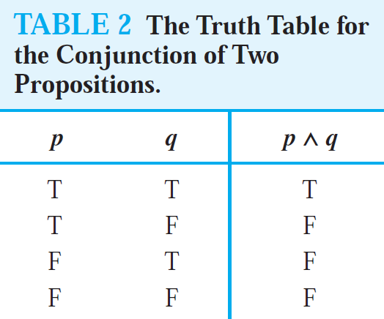
Truth Tables of Compound Propositions
Construct the truth table of the compound proposition
(p ∨¬q) → (p ∧ q).
The Truth Table of (p ∨¬q) → (p ∧ q) is

Slide 12
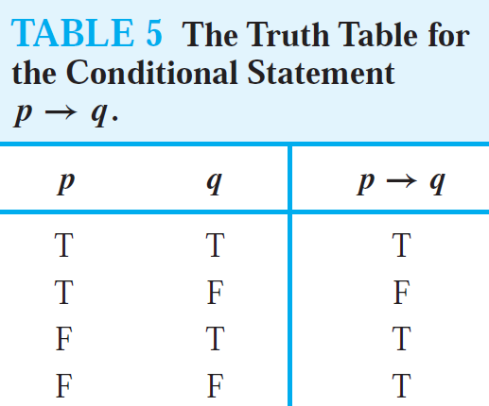
Truth Tables of Compound Propositions
Construct the truth table of the compound proposition
(p ∨¬q) → (p ∧ q).
The Truth Table of (p ∨¬q) → (p ∧ q) is

Slide 13
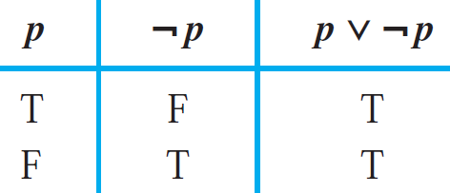
Tautology
DEFINITION:- A compound proposition that is always true, no matter what the truth values of the propositional variables that occur in it, is called a tautology.
Example of a Tautology

Slide 14
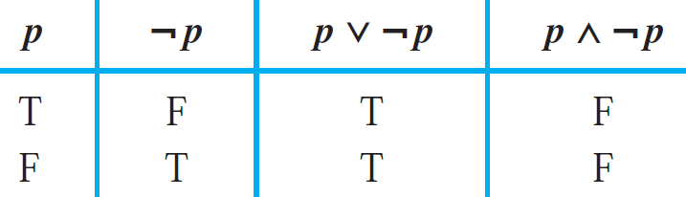
Contradiction
DEFINITION:- A compound proposition that is always false is called a contradiction.
Example of a Contradiction.

Slide 15
Contingency
DEFINITION:- A compound proposition that is neither a tautology nor a contradiction is called a contingency. As we can see in the truth table for conditional statement p → q.

Slide 16
Equivalence of formulas
The compound propositions p and q are called logically equivalent if p ⇔ q is a tautology.
The notation p ≡ q denotes that p and q are logically equivalent.

Slide 17
Equivalence of formulas
Remark 1: The symbol ≡ is not a logical connective, and p ≡ q is not a compound proposition but rather is the statement that p ⇔ q is a tautology.

Slide 18
Equivalence of formulas
Remark 2: The symbol ⇔ is sometimes used instead of ≡ to denote logical equivalence.
One way to determine whether two compound propositions are equivalent is to use a truth table.
In particular, the compound propositions p and q are equivalent if and only if the columns giving their truth values agree.

Slide 19
Equivalence of formulas
Following Example illustrates this method to establish an extremely important and useful logical equivalence, namely, that of ¬(p ∨ q) with ¬p ∧¬q.
This logical equivalence is one of the two De Morgan laws, shown in the following Table, named after the English mathematician Augustus De Morgan, of the mid-nineteenth century.

Slide 20
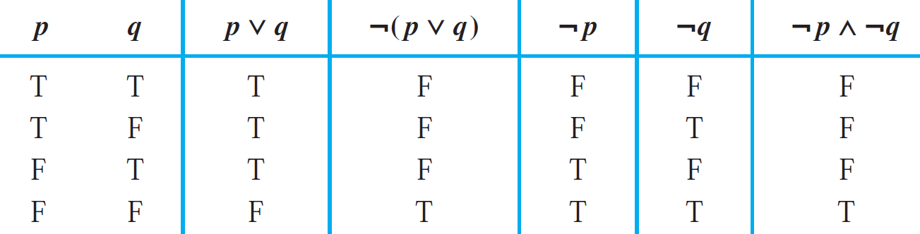
Equivalence of formulas – Example 1
De Morgan’s Laws.
1. ¬(p ∧ q) ≡ ¬p ∨¬q
2. ¬(p ∨ q) ≡ ¬p ∧¬q
Ques:- Show that
¬(p ∨ q) and ¬p ∧¬q are logically equivalent.
The truth table for ¬(p ∨ q) and ¬p ∧¬q is:-

Slide 21
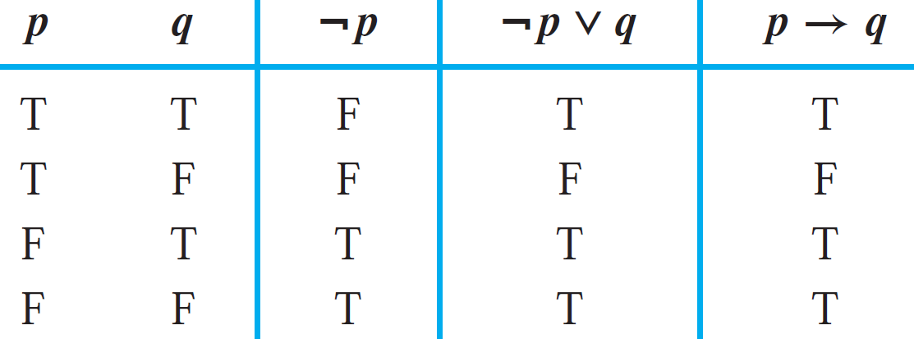
Equivalence of formulas – Example 2
Show that p → q and ¬p ∨ q are logically equivalent.
Truth Tables for ¬p ∨ q and p → q is

Slide 22
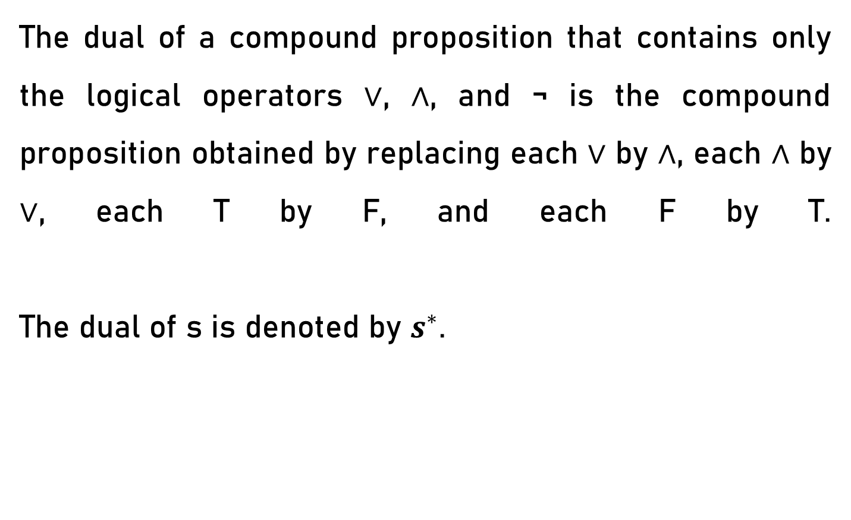
Duality law
The dual of a compound proposition that contains only the logical operators ∨, ∧, and ¬ is the compound proposition obtained by replacing each ∨ by ∧, each ∧ by ∨, each T by F, and each F by T.
The dual of s is denoted by $s^{∗}$.

Slide 23
Duality law – Example 1
Ques:- Find the dual of the compound proposition
p ∧¬q ∧¬r.
Ans:-p ∨ ¬q ∨ ¬r(replacing each ∨ by ∧, each ∧ by ∨)

Slide 24
Duality law – Example 2
Ques:- Find the dual of the compound proposition (p ∧ q ∧ r) ∨ s.
Ans:-(p ∨ q ∨ r) ∧ s(replacing each ∨ by ∧, each ∧ by ∨)

Slide 25
Duality law – Example 3
Ques:- Find the dual of the compound proposition (p ∨ F) ∧ (q ∨ T).
Ans:-(p ∧ T) ∨(q ∧ F)(replacing each ∨ by ∧, each ∧ by ∨, each T by F, and each F by T. )

